Slide 1
Magic Beans working screenshots

Slide 2
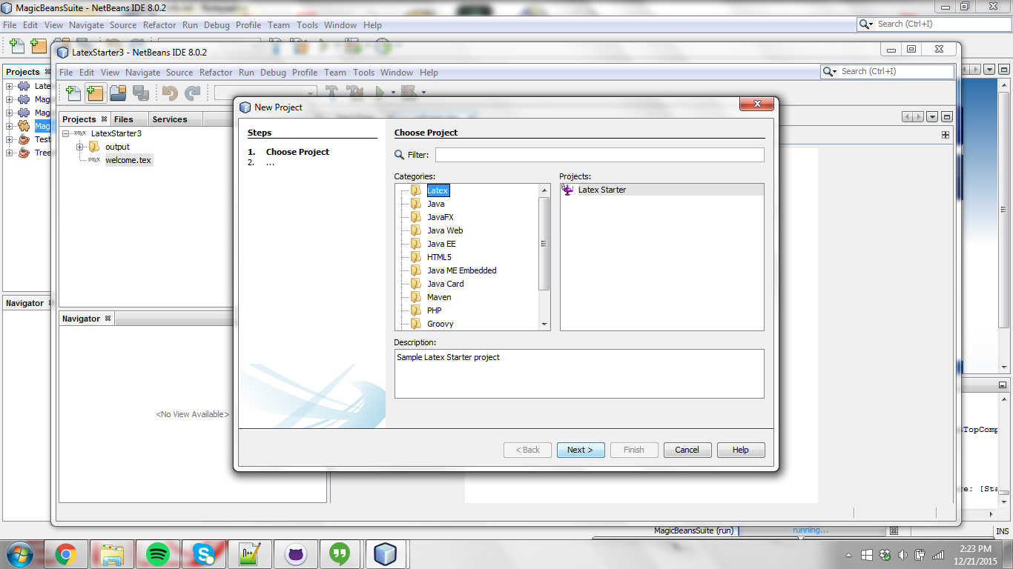
To make a Latex file project, just simply enter the new project menu and select “Latex Starter”

Slide 3
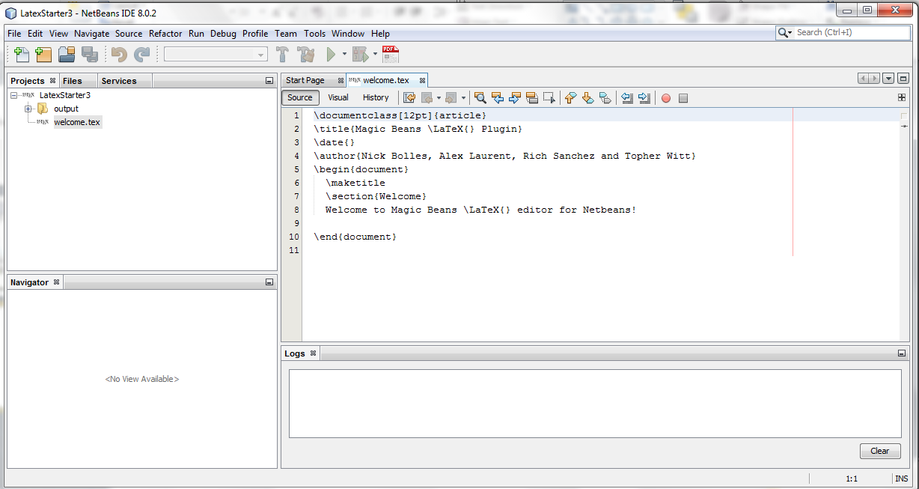
Press this button to save your .tex file as a pdf
This button opens the pdf preview tab
This navigator works the same as any other, and runs with other project types
You can now edit your .tex file in the editor like you would in any other project type, along with the other features shown above

Slide 4
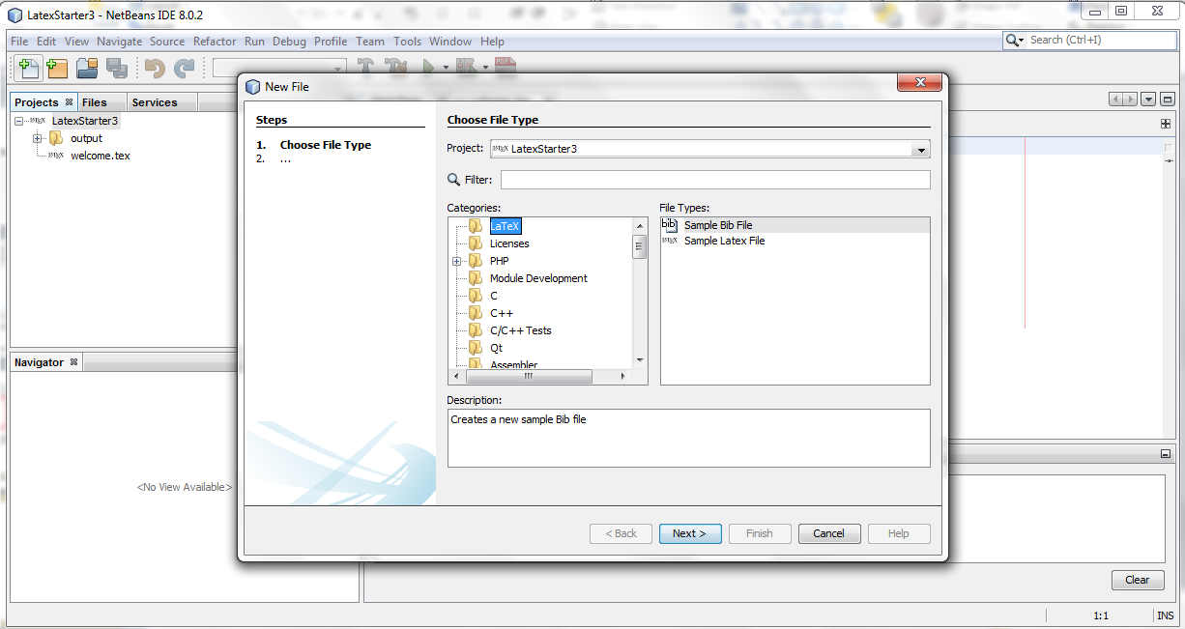
Add new files to your Latex package like you would normally by pressing the new file button, and in the Latex directory you will find .tex and .bib files

Slide 5
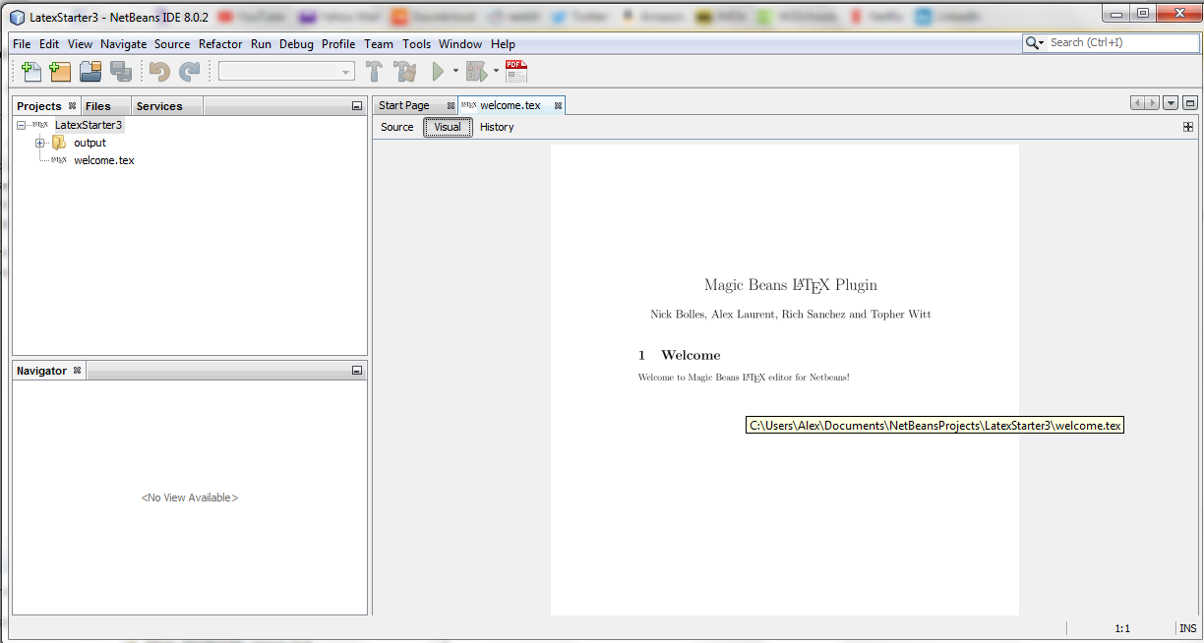
Functioning pdf preview
PDF saving and previewing is now functional in our project, you can save as PDF with the button, and tab over to the visual tab for a PDF preview

